Slide 1
Marketing Strategy Chapter 5 (Brands)
Marketing Principle #3
All Competitors React → Managing Brand-based Sustainable Competitive Advantage

Slide 2
Agenda
Introduction
Brand Strategies
Brand Positioning
Brand Architecture
Brand Extensions
Managing Brand-Based SCA
Three Steps to Building Brand Equity
Integrated Marketing Communications
Research Approaches to Understanding and Measuring Brand Equity
Surveys: Brand Audits
Takeaways

Slide 3
Brand Basics
The American Marketing Association defines brands as a “name, term, design, symbol, or any other feature that identifies one seller's good or service as distinct from those of other sellers”
Usually managers characterize a brand by describing all of the brand elements used to identify it, including its name (e.g., Apple), symbol (e.g., silhouette of an apple with a bite removed), package design (e.g., sleek white box), and any other features that serve to differentiate that brand’s offering from competitors’
A firm’s brand equity often represents a substantial portion of its overall value
Ranking of the 10 Most Valuable Global Brands
Notes:
Brand Basics
The American Marketing Association define brands as a “name, term, design, symbol, or any other feature that identifies one seller's good or service as distinct from those of other sellers.” Usually managers characterize a brand by describing all of the brand elements used to identify it, including its name (e.g., Apple), symbol (e.g., silhouette of an apple with a bite removed), package design (e.g., sleek white box), and any other features that serve to differentiate that brand’s offering from competitors’. Some firms, like IKEA and Siemens, use a stylized version of the firm’s name as the brand; other firms give unique names to each product they offer, such as Unilever’s Dove, Lipton, and Knorr product brands.
A firm’s brand equity often represents a substantial portion of its overall value. Interbrand’s list of the top 10 global brands in 2014 valued Apple’s brand at the top of the list at $118.2 billion, followed by Google ($107.4 billion) and Coca-Cola ($81.6 billion). Samsung ($45.5 billion), Toyota ($42.4 billion), and Mercedes Benz ($34.3 billion) were the only three non-U.S. firms to make the global list (Figure 5.1).

Slide 4
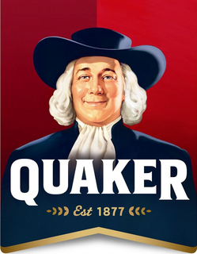
Brands Are One of the Most Critical (Intangible) Assets a Firm Owns
“If this company were to split up I would give you the property, plant, and equipment and I would take the brands and the trademarks and I would fare better then you” -John Stuart, 20 year CEO of Quaker Oats
Provides a long-term sustainable competitive advantage (SCA) that is very difficult to copy: How to displace Coke Cola, Apple, Google, IBM, McDonalds
Both brands and relationships lead to enduring customer loyalty
Price premium
Last look
Positive attributions
Cross selling and retention
Higher CLV
Notes:
Compare B2B and B2C

Slide 5
Brands as SCA
Customers’ awareness of, knowledge about, and behaviors in response to a brand generate the firm’s brand equity, one of the three major components of the customer equity stack, along with offering and relationship equities
Brand equity is the set of assets and liabilities linked to a brand, its name, and its symbol, which add to or subtract from the value provided by the firm’s offering and relationships
Brand equity “lies in the mind of the customer,” which means that it is difficult for competitors to copy it, adding to the sustainability of brand-based barriers
This also makes it hard for firms to adapt or change their brand identity
Understanding the brand-building process, as it takes place among consumers, can provide insights into many different brand-building strategies that firms might adopt, including which ones are most effective and why each strategy works best in any particular situation
Notes:
Brands as SCA
The third First Principle of marketing theory focuses on the importance of building and maintaining barriers to competitive attacks, or sustainable competitive advantages (SCA), because competitors are continually reacting to any firm’s success. Without these barriers or SCA, competitors ultimately undermine the firm’s business, taking its customers and damaging its financial performance. Investments to build brand awareness and brand images among customers can produce a strong competitive barrier. Such brand-related benefits often are the initial market-based SCA for a firm, because they stem directly from the firm’s strategic positioning and the overall marketing for all the company’s offerings. That is, the positioning statements generated in relation to MP#1 and MP#2 provide key information that help the firm design its brand message to make target customers aware of the brand and how it continues to meet their needs over time.
Customers’ awareness of, knowledge about, and behaviors in response to a brand generate the firm’s brand equity, one of the three major components of the customer equity stack, along with offering and relationship equities (Chapter 4). Brand equity is the set of assets and liabilities linked to a brand, its name, and its symbol, which add to or subtract from the value provided by the firm’s offering and relationships. For a firm, brand equity equals the sum of all the customer lifetime value (CLV) associated with all future and existing customers that can be attributed to the firm’s brand. Brands can influence consumers’ behavior, and brand equity captures the value of those behaviors to the firm.
Thus, brand equity “lies in the mind of the customer,” which means that it is difficult for competitors to copy it, adding to the sustainability of brand-based barriers. But this status also makes it hard for firms to adapt or change their brand identity. Apple could not rapidly gain a reputation as a low-price provider of basic computers for example, because the strength of its identity as a higher priced, innovative brand is firmly entrenched. If the power of brands as SCA thus depends on the minds of customers, then an important question emerges: How does an individual consumer’s mind process brand information? Understanding the brand-building process, as it takes place among consumers, can provide insights into many different brand-building strategies that firms might adopt, including which ones are most effective and why each strategy works best in any particular situation.

Slide 6
Associative Network Memory Model of Brand Equity
This leading psychological model describes how brands work
The associative network memory model argues that the human mind is a network of nodes and connecting links
The key characteristics of a brand, which influence its brand equity, are captured as nodes and linkages
Brand awareness or familiarity, which reflects the customer’s ability to identify a brand, is indicated by the size or strength of the node for that memory
Brand image, or customers’ perceptions and associations with the brand, are represented by the links of the brand name node to other informational nodes in the model
In the network memory model, brand strategy involves first building awareness to provide an anchor point, then building linkages to positive, unique memory nodes to establish an identity that matches target customers’ needs in a cost-efficient manner
Notes:
Associative Network Memory Model of Brand Equity. A leading psychological model describes how brands work. The associative network memory model argues that the human mind is a network of nodes and connecting links. The key characteristics of a brand, which influence its brand equity, are captured as nodes and linkages. Specifically, brand awareness or familiarity, which reflects the customer’s ability to identify a brand, is indicated by the size or strength of the node for that memory, as shown in Figure 5.2. It is often measured using aided and unaided recall tasks. Brand image, or customers’ perceptions and associations with the brand, are represented by the links of the brand name node to other informational nodes in the model. Unique linkages to a brand name capture the brand’s identity and differential (dis)advantage, relative to its competitors. The thickness of a line between two nodes represents the strength of the association between these two memories in a consumer’s mind.
A firm has many ways to strengthen or build positive linkages to a brand node, to ensure that the brand identity matches the ideal positioning in a target market. For example, Figure 5.2 represents an associative network memory model for a potential customer of BMW automobiles; the size of the BMW node represents a particular customer’s awareness of BMW. The more often a customer is exposed to BMW advertisements, riding in a friend’s BMW, or just seeing models on the road, the stronger BMW’s brand node becomes (i.e., it grows in size). Firms can measure the awareness of their brands by asking targeted customers to name 3 to 5 cars (unaided recall), or they can offer a list of 20 cars and ask customers to select the 3–5 that they are most familiar with (aided recall). Brand awareness is the frequency BMW with which is named.
If BMW’s marketing department wants to build more linkages with this node, it could pay to have James Bond drive a BMW in a movie, establishing a link between BMW and the James Bond node, as well as Bond’s existing linkages (e.g., sophisticated, ladies’ man, athletic), as shown in Figure 5.2. A movie placement can be very effective, because this single marketing move can link a constellation of characteristics to the central brand node, which would be more difficult to achieve through traditional television or print advertisements. In addition, movie placements often make these links more subtly, so (as long as they are not too heavy-handed) they can avoid the reactance and skepticism that customers often feel toward obvious paid advertising. But as Figure 5.2 shows, other product design features and tag lines (e.g., “Ultimate Driving Machine”) can be linked to the brand node using more traditional marketing strategies.
In the network memory model, brand strategy involves first building awareness to provide an anchor point, then building linkages to positive, unique memory nodes to establish an identity that matches target customers’ needs in a cost-efficient manner. When a customer sees (hears, touches) the brand name, it activates that brand node, leading to the cascading activation of other connected nodes—as long as strong linkages exist—which create the customer’s brand experience. Prior research has shown that these linkages can activate a wide range of cognitive and emotional responses.

Slide 7
Associative Network Memory Model of Brand Equity
Words in blue represent marketing strategies designed to build memory networks
Sophisticated
Ultimate driving machine
James Bond
Advertising
Movie placement
Ladies’ man
BMW
Grandpa’s car
Athletic
Product design
Line thickness reflects tie strength between nodes
Yuppie
Product attributes
Node size reflects ease of recall
German

Slide 8
Brand Differences Operate at a Subconscious Level
Colt 45
Pabst
Guinness
Guinness
Pabst
Coors
Budweiser
Colt 45
Miller Lite
Coors
Miller Lite
Budweiser
Taste perceptions of six beer brands when the drinker knows what he is drinking
Taste perceptions of six beer brands when the drinker does NOT know what he is drinking

Slide 9
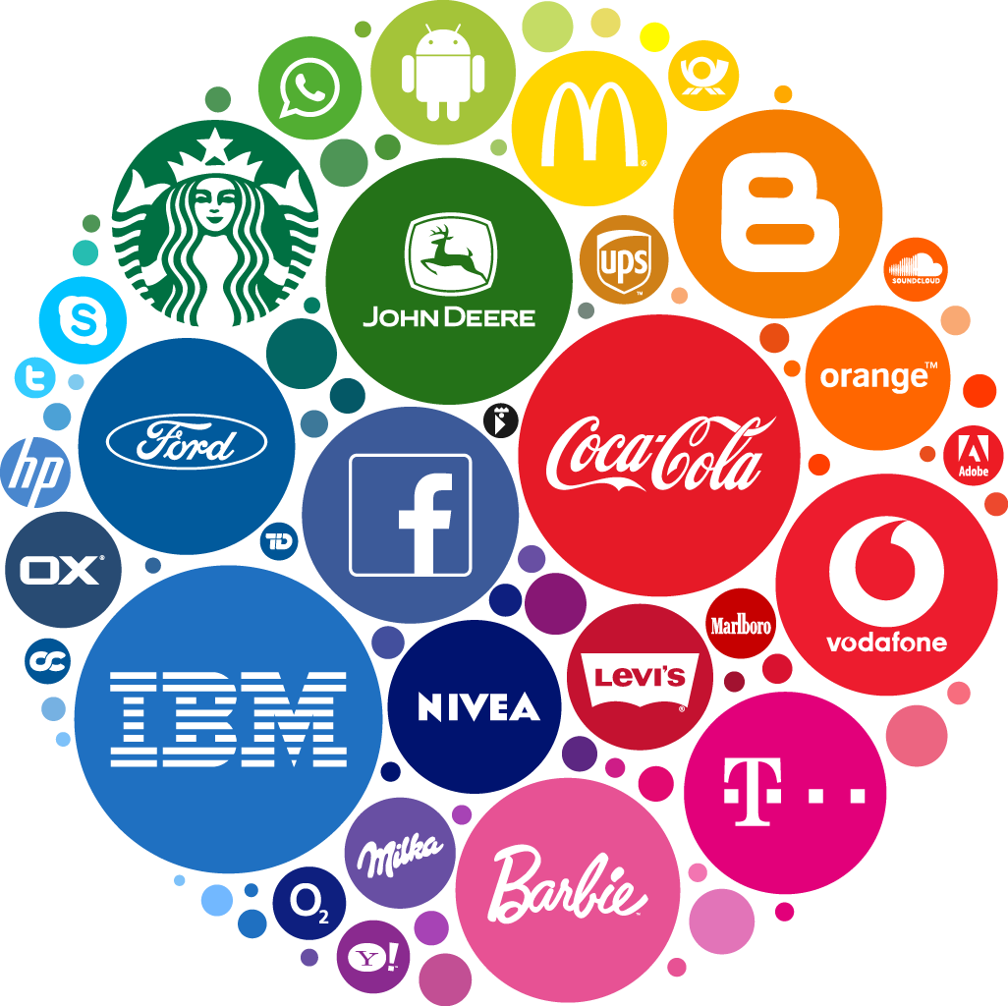
Benefits from Brand Equity
Brands can change customers’ actual experiences; they can change the taste of food or drink, the excitement of driving a car, the comfort felt in a coffee shop, and the visual appeal of diamond jewelry
Benefits from strong brands are associated with three general areas:
Sales growth – sales benefit from strong brands, because brands make it easier to acquire new customers, who perceive less risk, higher quality, and better performance of a brand with strong equity
Profit enhancement – the benefits that drive sales growth also can enhance a firm’s profitability by reducing costs or allowing the firm to charge higher prices for its products
Loyalty effects – a strong brand makes customers more loyal, which often provides the largest barrier to competitive entry
True loyalty
Spurious loyalty
Latent loyalty
Notes:
Benefits from Brand Equity. There are many benefits of building brand equity; together, these benefits ultimately can improve a firm’s sales, reduce its costs, and make it more difficult for competitors to encroach on the firm’s business. Brands change how people think, though often at a level below their conscious awareness, which makes it very difficult for customers to ignore brand effects. For example, one classic experiment shows that the taste of beer differs when the customer knows the brand of the beer she or he is drinking. Customers are not just repeating the brand messaging; the beer actually tastes different when linked to a brand name. Because brand identification activates a brand node associated with that beer, it spreads across other strongly linked nodes in the drinker’s memory network. Thus, the part of the brain that processes taste receives input from both the customer’s taste buds and the brand’s memory network. These two inputs then merge to establish the customer’s taste perceptions. Therefore, a key benefit is that brands can change customers’ actual experiences. They can change the taste of food or drink, the excitement of driving a car, the comfort felt in a coffee shop, and the visual appeal of diamond jewelry.
Most benefits from strong brands are associated with three general areas: sales growth, profit enhancement, and loyalty effects. First, sales benefit from strong brands, because brands make it easier to acquire new customers, who perceive less risk, higher quality, and better performance of a brand with strong equity. Similarly, it is easier for firms to launch new products, product extensions, and brand extensions, because their strong brand name provides protection, in the form of various attributes linked to the new introductions, even before the firm spends any of its marketing budget on the product launch. When Siemens launches a new electronic product, its brand identity (i.e., well-designed, highly reliable, German-engineered products) immediately attaches to the new offering. Furthermore, existing customers tend to speak positively about and recommend (i.e., word of mouth [WOM]) firms and products with high brand equity.
Second, the benefits that drive sales growth also can enhance a firm’s profitability by reducing costs (e.g., WOM provides free customer acquisition, relatively less marketing is needed to retain brand loyal customers) or allowing the firm to charge higher prices for its products. Higher prices often are inherently tied to brand positioning in a market. Chanel, Ferrari, and Gucci all charge significant premiums for their products, mostly due to customers’ perception of their exclusive brand image. These products help confer high status onto customers who use them, and that status is a key part of their brand equity. In addition, firms with strong brand equity can gain easier access to various sales channels (retailers, distributors, specialty catalogs, web platforms) than can competitors with less or no brand equity. In one study, Kellogg’s brand value emerged as more than 25 percent higher than that of General Mills, based on customers’ perceptions of each brand.
Third, a strong brand makes customers more loyal, which often provides the largest barrier to competitive entry. This significant source of SCA arises because strong brands generate more favorable attitudes (attitudinal loyalty), which skew customers’ perceptions and subsequent behaviors. If Apple suffers supply chain problems that lead to late product deliveries, many loyal customers would attribute the problems immediately to the company’s offshore suppliers. Apple’s strong brand protects it from the repercussions of such service failures, but if a similar problem were to plague Gateway or Acer, their customers likely would blame these weaker brands for the problems and perhaps even switch to a competitor to make their future purchases.
Strong brands also generate repeat purchase behaviors (behavioral loyalty), in the form of habitual purchase behavior, which can be reinforced by high brand awareness and the connection between the customer’s self-identity and the brand identity of the firm or product. When both attitudinal and behavioral loyalty are high, it creates true loyalty, manifested in consumers’ positive feelings and actions (see Figure 5.3). If they buy but have ambivalent or negative feelings (termed spurious loyalty), then at the first convenient opportunity, they will switch. For example, an employee might use a particular software package at work, because it is all that her employing firm supports, but if given a choice (e.g., on a personal computer), she gladly switches to a different system. Such customers are not truly loyal. On the flip side, customers might express positive attitudes but fail to actually buy a firm’s products, which constitutes latent loyalty. This form of loyalty often arises due to a lack of local purchase access or prices beyond their means.
Overall though, high brand equity enhances a firm’s sales and profits, allowing it to continue to market its products, conduct research and development, and fight competitors in a multitude of ways. A strong “war chest” earned from superior sales and profits gives the firm the resources and time it needs to respond to innovative product entries or low cost competitors; in some cases, it even might use these resources to acquire a firm that provides an existential threat to its survival. Because strong brands increase customers’ attitudinal and behavioral loyalty, switching behavior diminishes. Very loyalty customers avoid even evaluating competitive offerings, to prevent themselves from feeling tempted or disrupting their sense of supportive brand attachment.

Slide 10
True Loyalty Matrix
True loyalty: when both attitudinal and behavioral loyalty are high; positive feelings and actions
Spurious loyalty: customers buy but have ambivalent or negative feelings; at the first convenient opportunity they will switch
Latent loyalty: customers express positive attitudes but fail to actually buy a firm’s products. Often due to a lack of local purchase access or prices beyond their means
Behavioral Loyalty (repeat purchases)
High
Low
True Loyalty
high levels of both attitudinal and behavioral loyalty
Latent Loyalty
positive attitudes but does not buy the firm’s products
High
Attitudinal Loyalty (strong positive feelings)
Spurious Loyalty
buys products but has ambivalent or negative feelings
No Loyalty
no positive feelings and no purchases
Low

Slide 11
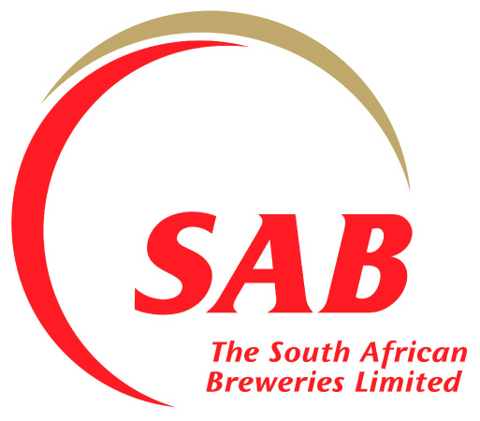
Example: SAB (South Africa)
South African Breweries (SAB) was named the “Most Admired Company in South Africa” by Ask Afrika, a South African market research company
SAB uses brand loyalty to prevent competitive entry
While many international brewers have attempted to gain a slice of SAB’s over 90% market share, SAB’s brand strength is a very difficult barrier to overcome
Notes:
Example: SAB (South Africa)
South African Breweries (SAB), named the “Most Admired Company in South Africa” by Ask Afrika, a South African market research company, is a prime example of using brand loyalty to prevent competitive entry. While many international brewers have attempted to gain a slice of SAB’s over 90% market share, SAB’s brand strength is a very difficult barrier to overcome.

Slide 12
Agenda
Introduction
Brand Strategies
Brand Positioning
Brand Architecture
Brand Extensions
Managing Brand-Based SCA
Three Steps to Building Brand Equity
Integrated Marketing Communications
Research Approaches to Understanding and Measuring Brand Equity
Surveys: Brand Audits
Takeaways

Slide 13
Brand Positioning
Brand positioning reflects how and where the firm hopes to appear in customers’ mind
The BOR Equity Grid provides the objectives, relative advantages (over competitors), and sources of sustainability (how it wins over time) that are required to use brands as SCA
But other design elements also are required to develop a brand strategy, including:
Brand objectives
Brand awareness
Brand relative advantage
Brand sustainability
Brand image
Brand identity
Notes:
Brand Positioning
Brand positioning reflects how and where the firm hopes to appear in customers’ mind. In a way, it reflects the firm’s ideal associative network memory model, the one it hopes that customers hold in mind. It captures the aspirational level of awareness, key associations, and overall product or company image the firm seeks in the marketplace. The BOR Equity Grid from Chapter 4 provides a starting point for this discussion, because it describes the marketing objectives associated with the brand strategy, the relative advantage(s) that the brand can offer over relevant competitors, and the source of the sustainability of this advantage. That is, it captures many of the elements that brand managers need to develop their brand strategies. The firm’s positioning statements are also important, though they can be more abstract or high level, rather than specific to the brand strategy. Furthermore, the AER strategies across personas, as outlined in the AER Strategy Grid, might be helpful, but they are unique to each persona and AER stage, whereas the brand needs to be consistent across all personas and stages. Generally, it is not possible to offer differentiated brand strategies at this level of granularity.
Thus, the BOR Equity Grid provides the objectives, relative advantages (over competitors), and sources of sustainability (how it wins over time) that are required to use brands as SCA. But other elements also are required to develop a brand strategy, including
Brand objectives, to describe what the brand needs to accomplish as a performance outcome, such as driving customer acquisition or generating a price premium by establishing a perception of status.
Brand awareness, which describes the firm’s desired level of recognition, as demonstrated by target customers’ ability to recall the firm’s brand name. Most firms prefer a high level of awareness, but achieving it requires substantial time and marketing expenditures, so it is important to specify a threshold level of awareness that the firm is willing to pay for, among a particular set of customers.
Brand relative advantage captures the brand’s points of difference (POD), or the key ways it differs from its competition. In addition, the points of parity (POP) are those aspects of the brand that may not be unique but still are required by customers in the target market.
Brand sustainability, or how the brand is going to maintain its relative advantage over time, whether by generating an exceptionally high level of awareness among difficult-to-reach decision makers or maintaining a tough-to-achieve but strong image that matches targeted customers’ self-identity.
Brand image, which describes the high-level, abstract perspective of the brand network, according to what comes to customers’ minds when they think of the brand. Brand associations instead describe the specific words, colors, logo, fonts, emotions, features, music, smells, people, animals, or symbols that are linked to a brand.
Brand identity pulls it all together and describes who the brand is. If it were a person, what would he or she be like? A brand’s identity is often subsumed by customers who use the product, because the customer seeks to connect the brand’s identity to their own self-identity.
If brand managers can describe all of these brand elements, they gain a clear picture of what they want the brand to do, know the key methods they are going to use to achieve their goals, and recognize many of the building blocks needed to develop a brand strategy. Two other strategic decisions also describe how these brand elements will apply to a firm’s various offerings over time: brand architecture and brand extensions.

Slide 14
Brand Architecture
Brand architecture defines both the rationale and the structure among the firm, its products, and its brand/product extensions—in essence, how the brand is used at different levels in the organization
One extreme is a house of brand architecture, such that the firm focuses on branding each major product with its own unique set of brand elements
Other extreme is a branded house architecture, where a firm uses a single set of brand elements for all of its products
Overall, firms should shift toward a house of brands approach if they need a separate brand for each entity (divisions, categories, products) to avoid a problematic association or channel conflict across entities
Notes:
Brand Architecture
Brand architecture defines both the rationale and the structure among the firm, its products, and its brand/product extensions—in essence, how the brand is used at different levels in the organization. As Figure 5.4 shows, at one extreme is a house of brand architecture, such that the firm focuses on branding each major product with its own unique set of brand elements (e.g., P&G, Inditex, Reckitt Benckiser). At the other end is a branded house architecture, where a firm uses a single set of brand elements for all of its products (e.g., GE, Mitsubishi, Virgin Group, Reliance Group). Thus P&G applies different brand elements to each of its major soap products (Tide, Cheer, All, Ariel, Purex) but devotes little effort or money to promoting the P&G parent brand. General Electric (GE) uses one set of brand elements for all of its products, across such diverse categories as aircraft engines, refrigerators, and real estate financing.
Why do firms select such different brand architectures when designing their brand strategies? Overall, firms should shift toward a house of brands approach if they need a separate brand for each entity (divisions, categories, products) to avoid a problematic association or channel conflict across entities.

Slide 15
Brand Architecture Spectrum
Many Independent Brands
Single Master Brand
House of Brands
Endorsed Brands
Sub-brands
Branded House
Many independent brands
Many individual brands are linked to an endorsing brand to produce a supportive foundation
Sub-brands have a closer link to the parent brand than do endorsed brands but behave similarly
Single master brand used for all products
P&G’s Tide, Cheer, All, Ariel, and Purex
Courtyard by Marriott; Polo by Ralph Lauren
Sony Walkman; Nestle Kit Kat
GE’s airplane engines, appliances, and financing
Despite this presentation of brand architecture as two extremes on a spectrum, in reality, firms often use intermediate or hybrid brand structures, such as endorsed brands and sub-branding
Marriott Hotels uses an endorsed brand strategy for the Courtyard Marriott chain. It suggests the approval and imprimatur of the Marriott brand but also makes it clear to customers that Courtyard hotels stand on their own and offer something different from typical Marriott hotels
Sony uses a sub-branding strategy when it assigns major product categories, such as PCs, the Viao brand name. Branding a laptop as a Sony Viao means that it enjoys spillover benefits from Sony (awareness and linkages) but also differentiates the Viao name so that it can establish linkages unique to PCs
Notes:
Despite this presentation of brand architecture as two extremes on a spectrum, in reality, firms often use intermediate or hybrid brand structures to gain the benefits of both approaches. Two types of hybrid brand architectures are endorsed brands and sub-branding.
Marriott hotels uses an endorsed brand strategy for the Courtyard Marriott chain. It suggests the approval and imprimatur of the Marriott brand but also makes it clear to customers that Courtyard hotels stand on their own and offer something different from typical Marriott hotels.
Sony instead uses a sub-branding strategy when it assigns some major product categories, such as PCs, the Viao brand name. Branding a laptop as a Sony Viao means that it enjoys spillover benefits from Sony (awareness and linkages) but also differentiates the Viao name so that it can establish linkages unique to PCs

Slide 16
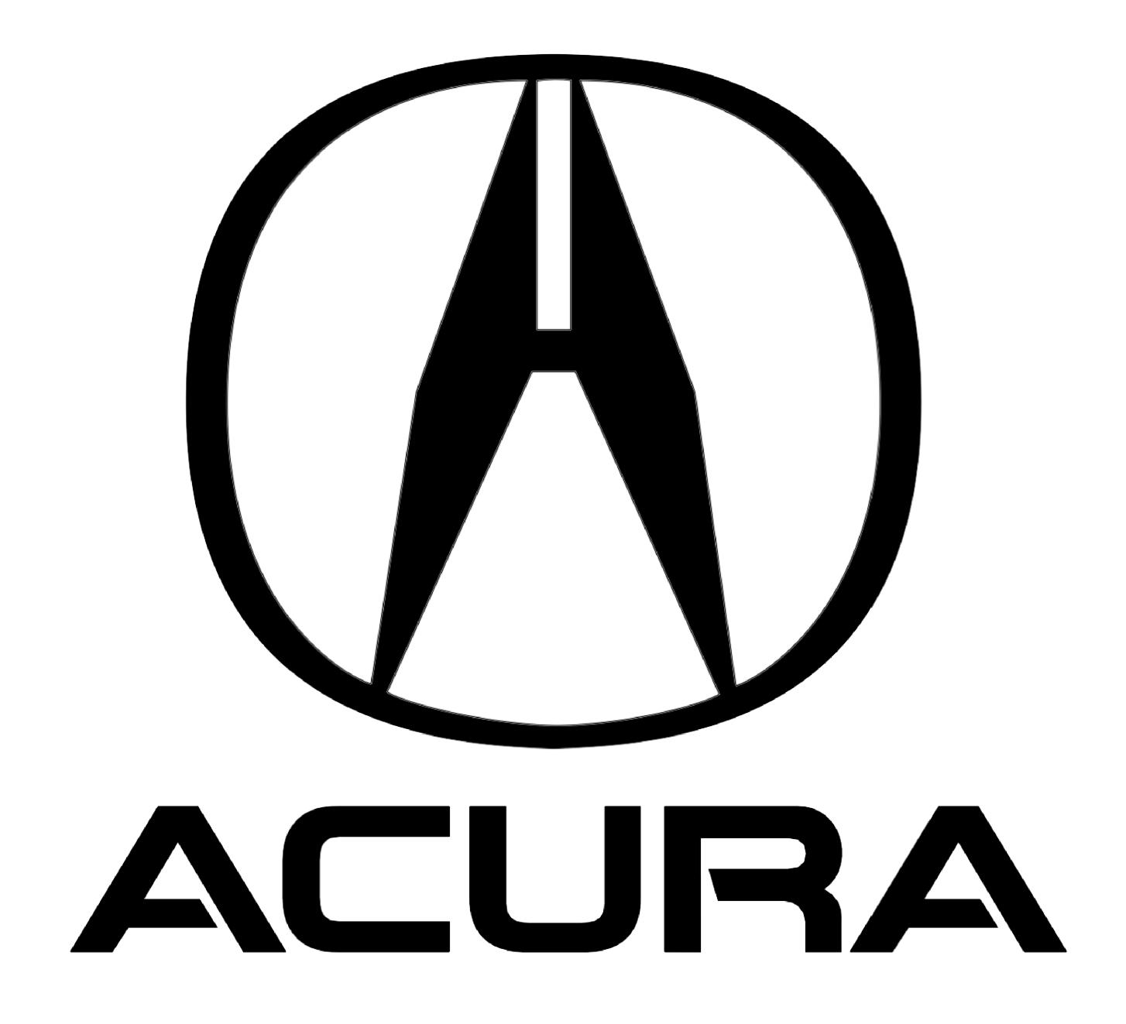
Example: Honda (Japan)
Honda launched Acura to target the luxury automotive market
Needed to give the cars a new, distinct brand identity to match customers’ desires for status and exclusivity, rather than the economy and reliability linked to the Honda brand
Similarly, Proctor and Gamble (P&G) maintains a full set of brand identities for all its products
In some grocery stores, P&G laundry detergents take up more than half of the shelf space for the category with Tide, Cheer, and All
Notes:
When Honda launched its Acura line to target the luxury automotive market, it needed to give the cars a new, distinct brand identity to match customers’ desires for status and exclusivity, rather than the economy and reliability linked to the Honda brand. Procter & Gamble does not want the same brand associations for its Pampers diaper brand and its Crest toothpaste brand, so these two products have totally different brand identities. Furthermore, P&G maintains a full set of brand identities for Tide, All, and Cheer laundry detergents so that it can target various customers with relatively similar products, but different brand identities, on the same retail shelf. Most customers are unaware that the same firm makes all of them; in some grocery stores, P&G laundry detergents take up more than half of the shelf space for this category. Such dominance would not be possible if all the products were branded with the P&G name. However, these benefits also come at a cost (literally). Every time P&G launches a new product category (e.g., Swiffer floor mops), it must spend tens if not hundreds of millions of dollars to build the brand from scratch. It cannot leverage the substantial equity it has already built into its other brands. Thus, a house of brands approach requires spending more marketing dollars every year to maintain the various brands, with few spillover benefits, even within the same portfolio.

Slide 17
Example: General Electric (US)
GE uses a branded house architecture
When GE launches a new product, it immediately enjoys the positive associations of the GE master brand
Product launch and brand building costs decrease, accelerates product diffusion throughout the marketplace
Each new GE product starts with high overall brand awareness and meaningful linkages to the high-quality manufacturer of electrical products, which lowers consumers’ perceptions of product adoption risk
However, these linkages must be credible. If GE were to launch a new line of perfume, many of its brand linkages would be inconsistent with the desired attributes for this new product, thus undermining the perfume’s own brand image
Notes:
A branded house approach then provides communication efficiencies; when GE launches a new product, like a stand-alone backup electrical generator for home use, it immediately enjoys the positive associations of the GE master brand, which are highly relevant for such a product. Not only do the product launch and brand building costs decrease, but these benefits also accelerate product diffusion throughout the marketplace. Each new GE product starts with high overall brand awareness and meaningful linkages to the high-quality manufacturer of electrical products, which lowers consumers’ perceptions of product adoption risk. However, these linkages must be credible. If GE were to launch a new line of perfume, many of its brand linkages would be inconsistent with the desired attributes for this new product, thus undermining the perfume’s own brand image.

Slide 18
Brand Extensions
Pertain to the approach the firm uses to launch new offerings by leveraging an existing brand, whether through line or category extensions
Brand line extensions (often called simply line extensions), the new offering is in the same product category but targets a different segment of customers, usually with a slightly different set of attributes
Brand category extensions, the new offering instead moves to a completely different product category
The key benefits that brand extensions offer a firm are:
Accelerates new product acceptance by reducing customers’ perceived risk.
Lowers the cost of new product launches by building on the established brand.
Reduces the time needed to build the new product’s brand by leveraging existing brand characteristics.
Increases the probability of gaining channel access by reducing perceived risk.
Helps enhance the image of the parent brand by linking it to newer and/or emerging product features.
Expands the size of the market that the firm can access, by serving additional subsegments with new offerings.
Notes:
Brand Extensions
Brand extensions pertain to the approach the firm uses to launch new offerings by leveraging an existing brand, whether through line or category extensions. In brand line extensions (often called simply line extensions), the new offering is in the same product category but targets a different segment of customers, usually with a slightly different set of attributes. Thus Crest toothpaste has launched at least 12 different types of toothpaste, for kids, people with dentures, and those who want whiter teeth. In brand category extensions, the new offering instead moves to a completely different product category, such as when Crest has introduced dental floss, mouthwash, and whitening strips.
About 80 percent of all product extensions are line extensions, which are less risky and enable the firm to address multiple customer segments with just slight variants to their focal product. Of the many benefits that brand extensions offer a firm, the following are key:
Accelerates new product acceptance by reducing customers’ perceived risk.
Lowers the cost of new product launches by building on the established brand.
Reduces the time needed to build the new product’s brand by leveraging existing brand characteristics.
Increases the probability of gaining channel access by reducing perceived risk.
Helps enhance the image of the parent brand by linking it to newer and/or emerging product features.
Expands the size of the market that the firm can access, by serving additional subsegments with new offerings.

Slide 19
Brand Extensions
Not all brand extensions achieve all these benefits
The many examples of unsuccessful brand extensions (e.g., Kleenex diapers, Ben-Gay aspirin, Smucker’s ketchup) highlight the limits on a firm’s ability to stretch its brand into new segments and categories
Over time, researchers have developed some guidelines for improving the chances of success for brand extensions:
There must be perceived fit between the parent brand’s image and the extension on a dimension that is relevant to the customer
Brand extensions can be stretched farther if done incrementally
Higher quality brands generally can be extended further
Vertical extensions of brands to lower priced markets often undermine the image of the parent brands
Notes:
However, not all brand extensions achieve all these benefits. The many examples of unsuccessful brand extensions (e.g., Kleenex diapers, Ben-Gay aspirin, Smucker’s ketchup) highlight the limits on a firm’s ability to stretch its brand into new segments and categories. Over time, researchers have developed some guidelines for improving the chances of success for brand extensions. First, there must be perceived fit between the parent brand’s image and the extension on a dimension that is relevant to the customer. Customers might evaluate fit according to a technical, manufacturing, or usage context, and it is not always easy to identify the most relevant dimensions.
Second, brand extensions can be stretched farther if done incrementally. For example, Oreo first began expanding simply by adding more filling to the middle or covering its traditional cookies with chocolate. As consumers grew accustomed to the idea of variations on their favorite treat, the brand’s owner gradually introduced more distant variations, reflecting customer demand. Oreo pie crusts were a natural extension, because many bakers already crushed up the cookies to line their homemade pies. Ice cream sandwiches were a slightly more risky extension, because they appear in a completely different section of the grocery store and require consumers to associate the Oreo brand with a frozen treat. Yet the sandwich concept helped make this incremental extension resonate with consumers.
Third, higher quality brands generally can be extended further. Porsche thus can sell branded clothing, gloves, sunglasses, luggage, paper clips (in the shape of a Porsche), and baby products. But Hyundai is unlikely to succeed if it were to seek to sell similar product extensions under its brand name.
Vertical extensions of brands to lower priced markets often undermine the image of the parent brands. But brand extensions can move upmarket, as well as down, to access new customers. When moving upmarket, the extension needs to be realistic, so customers recognize and accept the brand fit. In addition, the new upmarket product should be differentiated in some way. When moving a brand extension down market, the firm instead needs to elevate and differentiate the parent brand, to decrease any potential (negative) brand overlap and make the brand extension distinguishable in a clear way.

Slide 20
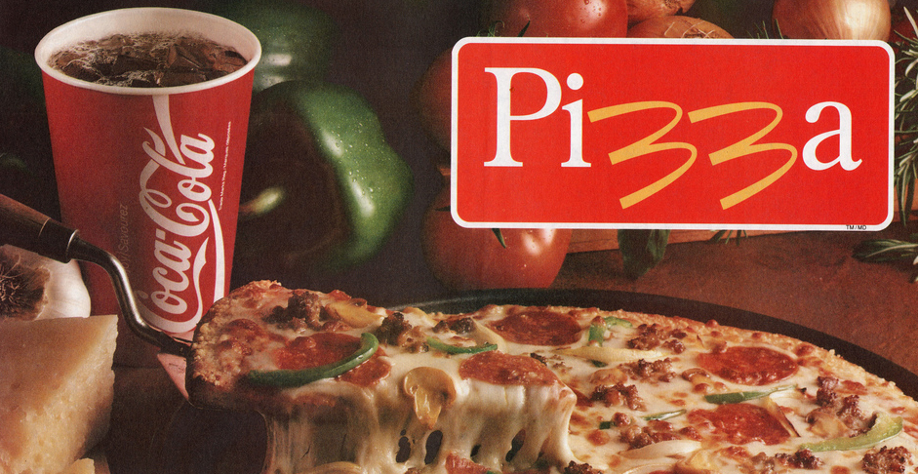
Example: McDonald’s (US)
McPizza a pizza extension under the McDonald’s brand name failed due to the lack of credibility McDonald’s had for making pizza, compared with established rivals like Dominos or Pizza Hut
In contrast, McCafe, McDonald’s attempt to brand its coffee and compete with Starbucks, succeeded as a brand extension. Customers had experience buying coffee from McDonald’s, so expanding their purchases to include flavored and espresso coffee options resonated with them
In another example, though Kleenex and diapers are both paper products that focus on absorption, the usage context of tissues seemed incongruent with imagining diapers on a baby’s bottom. Thus Kleenex diapers failed to capture any market share
Notes:
For example, McPizza (a pizza extension under the McDonald’s brand name) never made the profitable run it was expected to achieve, due to the lack of credibility McDonald’s had for making pizza, compared with established rivals like Dominos or Pizza Hut. In contrast, McCafe, McDonald’s attempt to brand its coffee and compete with Starbucks, led customers to perceive a credible brand extension: In this case, they had experience buying coffee from McDonald’s, so expanding their purchases to include flavored and espresso coffee options resonated with them. In another example, though Kleenex and diapers are both paper products that focus on absorption, the usage context of tissues seemed incongruent with imagining diapers on a baby’s bottom. Thus Kleenex diapers failed to capture any market share.

Slide 21
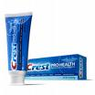
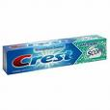
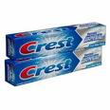
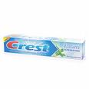
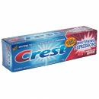
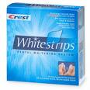
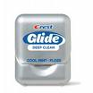
Line Versus Brand Extensions
Crest's Line Extension to 12 different types of toothpaste
Crest's Brand Extension to floss, mouthwash, and whitening strips

Slide 22
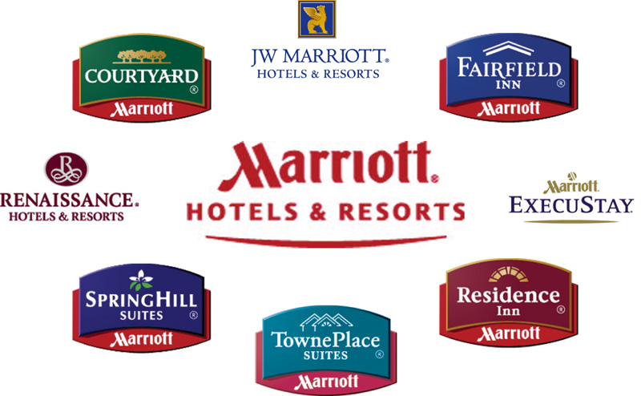
Has Marriott Been Successful at Moving Up and Down Market?
What about Ford’s launch of a low-end Jaguar X-Type?
© Palmatier

Slide 23
Guidelines For Optimizing Brand/Line/Vertical Extensions
Consumers should perceive fit between parent and extension, fit can be on many dimensions:
Product attributes and benefits
User types and situations
Manufacturing
High-quality brands stretch farther
Brands seen as prototypical are difficult to stretch (Bayer, Clorox soap)
Concrete associations are more difficult to extend (Shredded Wheat, La-Z-Boy)
Brands can be extended farther if done in incremental steps
Vertical extensions often hurt the parent brand and are best done with sub-brands
Most successful advertising for extensions are based on information about extension and not about parent brands

Slide 24
Agenda
Introduction
Brand Strategies
Brand Positioning
Brand Architecture
Brand Extensions
Managing Brand-Based SCA
Three Steps to Building Brand Equity
Integrated Marketing Communications
Research Approaches to Understanding and Measuring Brand Equity
Surveys: Brand Audits
Takeaways

Slide 25
Three Steps to Building Brand Equity
Brand Building Activities
Key Objectives
1st
Step
Build a high level of brand awareness
Provide an anchor point for linking meaning to the brand in later steps
2nd
Step
Link the brand name to its points of parity and difference
Define the brand’s relative advantage(s)
3rd
Step
Build a deep emotional connection or “relationship” between brand and targeted customers
Generate powerful, long-lasting barriers to competitors (i.e., SCA)
Building a high level of brand awareness among the firm’s targeted customers, which then provides an anchor point for linking the easily recallable brand name to the elements that define its meaning and image
Linking the brand name to the brand’s points of parity and difference, which helps define the brand’s relative advantage – this step defines how the brand will be positioned against its competition
Building a deep emotional connection or “relationship” between the brand and targeted customers – moving beyond functional differentiation implies a true, emotional connection which is the essence of building a powerful, long-lasting brand image
Notes:
Three Steps to Building Brand Equity
The three key steps to building brand equity to increase a firm’s SCA start with building a high level of brand awareness among the firm’s targeted customers, which then provides an anchor point for linking the easily recallable brand name to the elements that define its meaning and image (Figure 5.5). Building awareness involves making the brand easy to recall (i.e., brand depth) across a wide range of potential purchase and usage situations (i.e., brand breadth). Awareness should be high for the complete constellation of brand name elements: its name, logo, jingle, package shape, and other elements that the firm uses to identify its offering.
Then the second step links the brand name to the brand’s points of parity and difference, which helps define the brand’s relative advantage. This step defines how the brand will be positioned against its competition. Some linkages might get transferred from the parent brand, depending on the firm’s brand architecture. For example, when Erickson or Nokia launches a new product under their strong parent brands, the new product’s subbrands immediately take on some meaning from those parents. To establish what the brand means to customers, brand managers typically start with points of parity related to how the brand meets some basic level of performance, then add key points of difference that reflect how or why this brand will perform “better” than competitive options. Because points of difference are a key relative advantage of a brand when it first launches, significant financial resources and promotional efforts are applied to make these differentiation points memorable and link them strongly to the brand name.
The third step involves building a deep emotional connection or “relationship” between the brand and targeted customers. Moving beyond functional differentiation implies a true, emotional connection—the essence of building a powerful, long-lasting brand image. A strong brand image often is what provides a firm a long-term sustainable advantage, because it connects with consumers at a deep level and is hard for competitors to replicate. If a brand can connect to an individual consumer’s self-identity or who they want to be, that customer often exhibits high levels of both attitudinal and behavioral loyalty (i.e., true loyalty). It also can drive positive WOM, transforming customers into strong brand advocates.
All three steps are evident in Coca-Cola’s “Share a Coke” campaign. Launched in June 2014, the marketing campaign featured personalized bottles, in which the traditional Coke logo was replaced with 250 of the most common names among U.S. millennials. By adding names to bottles, Coca-Cola created a powerful connection between an individual consumer and the brand; it also offered nearly endless storytelling potential. The campaign was a massive success, generating more than 125,000 posts on social media, over 353,000 shares of virtual bottles through the campaign website, and a 96 percent positive or neutral sentiment toward the campaign.

Slide 26
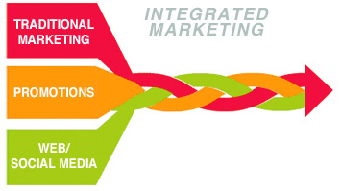
Integrated Marketing Communications
Integrated marketing communications (IMC) refers to the process of designing and delivering marketing messages to customers while ensuring that they are relevant and consistent over time and channels
To execute the three brand building steps and effectively implement the firm’s brand strategy, a firm typically uses multiple marketing communication formats, each of which has different strengths and weaknesses that define when each will be most effective, as well as the optimal combination of different formats
Some of the most commonly used marketing communication formats are:
Advertising
Sales promotion
Public relations (PR)
Events and experiential marketing
Direct and interactive marketing
Word-of-mouth (WOM)
Personal selling
Notes:
Integrated Marketing Communications
Integrated marketing communications (IMC) refers to the process of designing and delivering marketing messages to customers while ensuring that they are relevant and consistent over time and channels. To execute the three brand building steps and effectively implement the firm’s brand strategy, a firm typically uses multiple marketing communication formats, each of which has different strengths and weaknesses that define when each will be most effective, as well as the optimal combination of different formats. Some of the most commonly used marketing communication formats, and their key strengths, are as follows:
Advertising is a form of communication that businesses use to persuade customers to act, think, or recognize in ways favorable to their firm. Its implementation may involve print, audio, or visual media; these formats have evolved to fit customers’ appetite for different channels of communication. Advertising offers an important means to increase customer awareness and perceptions of a firm, gain access to new customers, and improve the company’s standing. The benefits of a successful ad campaign also can detract from the standing of rival firms, which improves the relative position of the advertiser, both within its targeted market and beyond. Advertising is very effective in customer markets, especially when the firm’s target market includes large numbers of customers. Icons created during the golden age of advertising include the Golden Arches, the Nokia jingle, and the seven rings of the Olympic Games.
Sales promotion refers to any action a firm takes to promote sales, usage, or recognition of its products or services. The focal methods might include add-on benefits, deals, or other pitches that incentivize both old and new customers to become more engaged with the promoting firm. Its main strength is its ability to increase tangible consumption of the firm’s offering. In addition, sales promotions with retailers and resellers can encourage those supply chain partners to buy up stock or inventory in exchange for a bonus. Examples include buy-one-get-one-free deals, mail-in rebates, coupons, prizes, and tradeshow sales pushes, all of which require an immediate purchase that will boost sales, at least in the short term.
Public relations (PR), according to the Public Relations Society of America, is “a strategic communication process that builds mutually beneficial relationships between organizations and their publics.” It requires managing dynamic interactions between firms and customers to manage the brand’s image for the outside world in the best possible light by anticipating, planning, and evaluating customers’ reactions to important company decisions. The strength of a firm’s PR team can often determine the public opinion of key company decisions, which should signal courses of action and choices to be made at all levels of management to further the cause of a company. Whether in the form of customer service, community building, or press releases, PR has the capability to affect the image and goals of the company in the public sphere. SeaWorld faced a PR nightmare following the release of a documentary that accused it of animal abuse—a relationship damaging event so impactful that it continues to influence choices by vacationers. The PR undertaken by smaller, more niche companies such as Razer instead results from community managers’ attempts to build tight-knit communities of online gamers, such that the relationship between the firm and the customer grows stronger.
Events and experiential marketing work exactly as it sounds: by creating positive experiences for customers through events that support face-to-face contacts between companies and customers. By engaging customers in a voluntary, participatory way, the practice offers the most effectiveness when the focal event grabs attention and provides further value to the customer, such as through a free sample, discount, or other bonus. A successful event and experience marketing program ties the positive interaction by a customer and an event to the company that is putting on the show, creating a long-lasting relationship that is based on the combination of a good impression of the company and a sense of involvement or togetherness with the brand. Nothing screams “experience” quite as well as Red Bull’s sponsorship and extensive online coverage of Felix Baumgartner’s stratosphere jump, tying the rush and thrill of the event to the brand image that Red Bull seeks to promote as an energy drink for extreme, energetic consumers.
Direct and interactive marketing are two distinct but closely related strategies. Direct marketing funnels information about goods and services straight to customers, without a middleman, using channels such as mail, television, and telemarketing. It’s the most simple and direct way of reaching out to and establishing personal relationships with potential customers, with the convenience of being available directly in the customers’ homes. Interactive marketing then attempts to overcome the one-sided limitations of direct marketing by incorporating feedback from and decisions by a customer into what is being advertised. For example, Amazon markets directly to customers with its recommendations, but these suggestions also are personalized for each user, on the basis of algorithms that account for what the user has looked at in the past. This interactive form of marketing thus is more focused and more likely to suggest the goods and services desired by unique customers, which should increase the possibility of a sale. It also enables the firm to appeal to as many market niches as possible.
Word-of-mouth (WOM) advertising is the dissemination of information by individual customers to build a firm’s or product’s reputation and generate sales. This form of marketing relies on satisfied customers, using their own reputation to vouch for the reliability, quality, and appeal of the product or service in question. In this sense, WOM marketing is very effective, because customers’ friends or family vouch for the efficacy of a product or service. Although it is difficult to manage, the rise of social media has moved WOM into the digital realm, in the form of “shares,” “likes,” and “favorites.” This digital WOM also has redefined “buzz” by tying it to certain keywords. Therefore, the popularity of an ad campaign focused on WOM is easier to track. One recent study revealed that consumers were willing to pay more for a product with an “excellent” rating (5) than for one with a “good” rating (4); the premiums reached an astounding 99 percent for legal services, along with 38 percent for hotels and 20 percent for real estate agents.
Personal selling occurs when members of the firm or agents engage with customers to advance the firm’s interests. They play various roles in the overall process of finding, securing, and closing a sale. For example, sales force personnel are often essential representations of the firm; they create a human point of contact for customers. A well-trained, motivated sales force often is especially critical in business-to-business (B2B) settings, because of the relatively few customers in a B2B firm’s target market and the more complex nature of their offerings and selling processes. Both IBM and Siemens expend most of their marketing budgets on maintaining a direct sales organization that carries their marketing message to their B2B customers, while also building relationship equity (see Chapter 7), in addition to brand equity.

Slide 27
Persuasion Process when Using IMC
Using brands as an SCA is often most effective in large consumer markets, such as those for soft drinks, beer, fashion, or automobiles
When making allocation decisions across different marketing communication formats, in the pursuit of key brand-building objectives, it also can be helpful to understand how customers process information and are persuaded to change their behavior
The varied models can be broken down into six steps that customers must pass through to be persuaded by the different communication formats:
The customer must be exposed to the communication message, whether that means hearing or seeing it.
The message needs to capture customers’ attention, so that they receive it.
The customer must understand the desired marketing message.
The customer needs to develop favorable attitudes toward the message.
The customer must generate intentions to act, in accordance with the information in the communication message.
The person then must actually behave in the desired way.
This six-step process sometimes is simplified as the “think → feel → act” model, which aligns well with the process for building brand equity
Notes:
Using brands as an SCA is often most effective in large consumer markets, such as those for soft drinks, beer, fashion, or automobiles. Firms invest heavily in advertising, PR, and celebrity sponsors to build both brand awareness and brand images in customers’ minds and ensure that these images match the firm’s positioning strategy. Personal selling is more effective in B2B markets, with fewer customers, a longer and more complex sales process, and business customers who need a customized and solutions-oriented approach. Yet at the same time, traditional distinctions about which marketing communication format is most effective for consumer versus business markets also are blurring. In the early 1990s for example, computer microprocessors were a relatively unknown component of personal computers: unseen by the consumer, not understood in their function or design, and ignored by most end customers. After failing to trademark its naming conventions for its microprocessors, Intel decided to launch a new marketing program with its business customers and original equipment manufacturers (OEMs) such as Dell, Hewlett-Packard, and Sony, in an effort to create brand awareness among those end customers. As the OEMs began placing “Intel Inside” logos in their advertising and marketing materials,
The name ‘Intel Inside’ became one of the first trademarks in the electrical component industry. This campaign focused the entire organization around the brand and created a highly effective advertising campaign. The Intel Inside campaign aimed to ‘educate both the retail sales associates and the customers about the value of Intel microprocessors, and to explain to them the differences between the microprocessors’—without the technical jargon.
Within just a few years, Intel had successfully created a sense that any computer sold without the “Intel Inside” logo was inferior in quality.
When making allocation decisions across different marketing communication formats, in the pursuit of key brand-building objectives, it also can be helpful to understand how customers process information and are persuaded to change their behavior. Across the many and varied models of communication and information processing, most of them can be broken down into six steps that customers must pass through to be persuaded by the different communication formats:
The customer must be exposed to the communication message, whether that means hearing or seeing it.
The message needs to capture customers’ attention, so that they receive it.
The customer must understand the desired marketing message.
The customer needs to develop favorable attitudes toward the message.
The customer must generate intentions to act, in accordance with the information in the communication message.
The person then must actually behave in the desired way.
This six-step process sometimes is simplified as the “think → feel → act” model, which aligns well with the process for building brand equity.
The intuition behind IMC is that super-additive benefits accrue across communication vehicles. Consumers view multiple media in bits and pieces, but they also frequently see advertising from the same firm across multiple media channels. Seeing an advertisement from the same firm in a new medium can induce memory reinforcement effects, such that the consumer remembers the previous advertisement because he or she has seen the second advertisement. The purchase of the firm’s product then is due to the joint persuasiveness of both advertisements. The first advertising medium’s effectiveness increases, due to the presence of the second medium (and vice versa), which means the integrated message is more powerful than both messages working individually. A key characteristic of effective IMC thus is the consistency of the message across formats and time. That is, each marketing communication format has it own specific strengths, but a deep and broad awareness of the brand and links from the customer to the brand require congruency and a lack of conflict. Otherwise, marketing expenditures will cancel each other out and leave customers unsure of the brand’s actual positioning. For example, noting research that suggested its customers wanted a high-end burger, McDonalds launched the “Arch Deluxe,” a burger “with the grown-up taste.” It sought to convey a brand image of sophistication and refinement—images that conflicted with McDonald’s existing, and powerful, brand, which was built on convenience. The complexity associated with imagining a new line of “sophisticated” products confused customers who understood the simplicity of the McDonald’s brand. After spending more than $100 million on advertising, McDonald’s quietly pulled the Arch Deluxe.

Slide 28
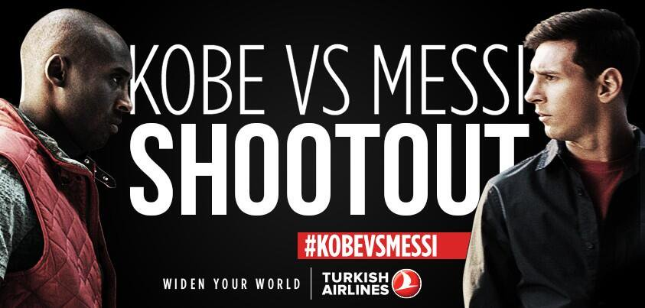
Example: Turkish Airlines (Turkey)
Turkish Airlines has been investing in sponsorship agreements and advertisements in order to expand its brand visibility and global reach
Its advertisement titled “Kobe vs. Messi: The Selfie Shootout” has been viewed more than 100 million times on YouTube, and was named the advertisement of the decade in 2013
Notes:
Turkish Airlines has been investing in sponsorship agreements and advertisements in order to expand its brand visibility among the target audience while emphasizing its global reach. Its advertisement titled “Kobe vs. Messi: The Selfie Shootout” has been viewed more than 100 million times on YouTube, and was named the advertisement of the decade in 2013.

Slide 29
Research Approaches for Understanding and Measuring Brand Equity
To track the effectiveness or returns on marketing expenditures that seek to build brand equity over time, as well as understand the state of the brand following changes in strategy or competitive disruptions in the marketplace, a firm needs to measure its brand equity
Different approaches, methods, and metrics for measuring a brand’s health are available, depending on the manager’s objectives
A brand audit evaluates the brand’s health to understand its strengths and weaknesses, such that it provides a foundation for designing and implementing a new brand strategy
With an exploratory qualitative analysis, the less structured method can use smaller samples

Slide 30
DAT 5.1
Survey Design: A Brand Audit Example
Description
When to Use It
Surveys are used to gather customer feed- back about a firm, experience, or brand, by asking customers to respond to a series of questions.
To understand how customers think or feel about an entity or topic (e.g., brand, new product).
Best to use when such feelings or thoughts are not observable in other types of data.
Designing a Survey
Experiments can establish the causal impact of marketing actions (e.g., new ad campaign), but they often cannot answer “why” or “how” questions: Why did customers respond so positively to that ad campaign? What makes them love a brand so much that they pay more just to buy it? How do customers make up their minds about whether to buy a certain brand? In such cases, surveys offer a clear advantage. They directly elicit responses from customers (or potential customers), and thus they provide deep, qualitative and quantitative feedback to the brand about its standing in the marketplace. To conduct a good survey, the firm must take into account four crucial factors:
The objectives for conducting the survey must be clear. A firm should have a specific, written statement of how the survey findings will relate back to the firm’s marketing program. Some objectives might include gauging responsiveness to a firm’s advertising efforts (to help it tweak its advertising copy), obtaining feedback on service staff (to improve service quality), or comparing the preferences of customers who use or don’t use the firm’s products (to understand the target population).
The firm must be careful to sample customers appropriately for any survey. Appropriateness involves obtaining a credible quantity (i.e., number of responses) but also credible quality, such that the firm receives relevant feedback according to the criteria used to separate those who are included in the survey from those who are not. If a firm is conducting a survey to obtain feedback about its service staff, for example, it needs to make the survey available to customers who recently used its service, because they are the ones most likely to recall the service experience accurately.
Surveys should contain penetrating, precise questions. Designing questionnaires is one of the most important parts of the survey design. All questions must measure the property they are supposed to measure, and they must mean the same thing to everyone. Furthermore, survey designers need to avoid the pitfall of asking loaded questions, which will cause a response bias. Thus, writing survey questions is an iterative process.
The firm should conduct the survey and store the data in a structured format, following a consistent process for organizing and analyzing survey data. The process should be defined well before it ever receives the first responses. Then the survey responses should be analyzed qualitatively (open-ended questions) or quantitatively (scale-type questions), often with the assistance of analytical software.
30

Slide 31
DAT 5.1
Survey Design: A Brand Audit Example (cont.)
Brand Audit Example
Brand A is one of 16 luxury cars available in India. To understand how it is perceived by customers, and improve its brand appeal, the owners of the brand conducted a nationwide, online survey of customers. An excerpt from the survey is presented below.
^{Survey}
You are cordially invited to provide your valued opinion in a short survey about luxury cars. We will ask you a few questions about various brands of luxury cars, and this survey should take you about eight minutes to complete. Thank you very much for your time and support.
Results
The survey was answered by 1,000 customers. The results reflect the brand’s image (comprised of mystery, sensuality, and intimacy). According to the questionnaire responses, Brand A scored very well on brand mystery and brand intimacy, with mean scores in the range of 4.2 to 4.9 on the 5-point scale. But customers did not like the brand’s design (M = 3.8) and did not believe that the brand sold incredible products (M = 3.3). Thus, the brand sensuality measures were significantly lower. Using these survey results, the firm launched an immediate redesign of its car to address this brand weakness and planned a new advertising campaign to launch the new product.
Brand Image
Think of Brand A, and please answer these questions. For each question, a score of 1 is regarded as “strongly disagree” and 5 is regarded as “strongly agree.”
Brand Mystery
Brand A awakens good memories for me.
Brand A is part of my life.
Brand A captures the times.
Brand Sensuality
Brand A’s design is really well done.
Brand A sells incredible cars.
Brand A’s products are designed to please.
Brand Intimacy
I feel happy when I use Brand A’s products.
I feel satisfied with Brand A.
I will stay with Brand A.
31

Slide 32
DAT 5.1
Survey Design: A Brand Audit Example (cont.)
Brand Audit Example (cont.)
32

Slide 33
Agenda
Introduction
Brand Strategies
Brand Positioning
Brand Architecture
Brand Extensions
Managing Brand-Based SCA
Three Steps to Building Brand Equity
Integrated Marketing Communications
Research Approaches to Understanding and Measuring Brand Equity
Surveys: Brand Audits
Takeaways

Slide 34
Takeaways
Investments in building a firm’s brand awareness and image in customers’ minds represent a strong barrier to competitive attacks and often provide the initial market-based SCA for a firm.
The associative network memory model argues that the mind is a network of nodes and connecting links. The key characteristics of a brand that influence brand equity can be captured as nodes and linkages.
Brands change how people think, often below a conscious level. Perceptions of brands even can change customers’ actual experiences (e.g., making beer taste better).
Benefits from strong brand equity include sales, profit enhancement, and loyalty effects.
Key branding elements include the brand objective, brand awareness, brand relative advantage, brand sustainability, brand image, and brand identity.
Notes:
Investments in building a firm’s brand awareness and image in customers’ minds represent a strong barrier to competitive attacks and often provide the initial market-based SCA for a firm.
The associative network memory model argues that the mind is a network of nodes and connecting links. The key characteristics of a brand that influence brand equity can be captured as nodes and linkages.
Brands change how people think, often below a conscious level. Perceptions of brands even can change customers’ actual experiences (e.g., making beer taste better).
Benefits from strong brand equity include sales, profit enhancement, and loyalty effects.
Key branding elements include the brand objective, brand awareness, brand relative advantage, brand sustainability, brand image, and brand identity.

Slide 35
Takeaways
Brand architecture defines the rationale and structure that link the firm, its products, and its product and/or brand extensions. It defines how the brand is used at different levels across the organization. Noting the range of brand architecture structures available, firms must make strategic decisions, based on their branding strategy.
Brand extensions can leverage existing brands as line or category extensions.
The three steps to building brand equity are: building a high level of brand awareness, linking the brand name to the brand’s points of parity and difference, and building a deep emotional connection or “relationship” between the brand and targeted customers.
Integrated marketing communication (IMC) is a process for sharing relevant, consistent marketing messages with consumers, across a variety of formats, including advertising, sales promotion, public relations, events and experiential marketing, direct and interactive marketing, word of mouth, and personal selling.
To understand and measure brand equity, firms use qualitative and quantitative assessments of their brand’s health, which helps them identify areas for improvement.
Notes:
Brand architecture defines the rationale and structure that link the firm, its products, and its product and/or brand extensions. It defines how the brand is used at different levels across the organization. Noting the range of brand architecture structures available, firms must make strategic decisions, based on their branding strategy.
Brand extensions can leverage existing brands as line or category extensions.
The three steps to building brand equity are: building a high level of brand awareness, linking the brand name to the brand’s points of parity and difference, and building a deep emotional connection or “relationship” between the brand and targeted customers.
Integrated marketing communication (IMC) is a process for sharing relevant, consistent marketing messages with consumers, across a variety of formats, including advertising, sales promotion, public relations, events and experiential marketing, direct and interactive marketing, word of mouth, and personal selling.
To understand and measure brand equity, firms use qualitative and quantitative assessments of their brand’s health, which helps them identify areas for improvement.

Slide 36
Readings
Perspectives on Brand Equity (overall review of brand equity, brand management, and brand measurement)
Measuring Brand Health to Improve Top-Line Growth (brand measurement and review of advertising behavioral models)
Marketing Strategy Book: Chapter 5

